Slide 1
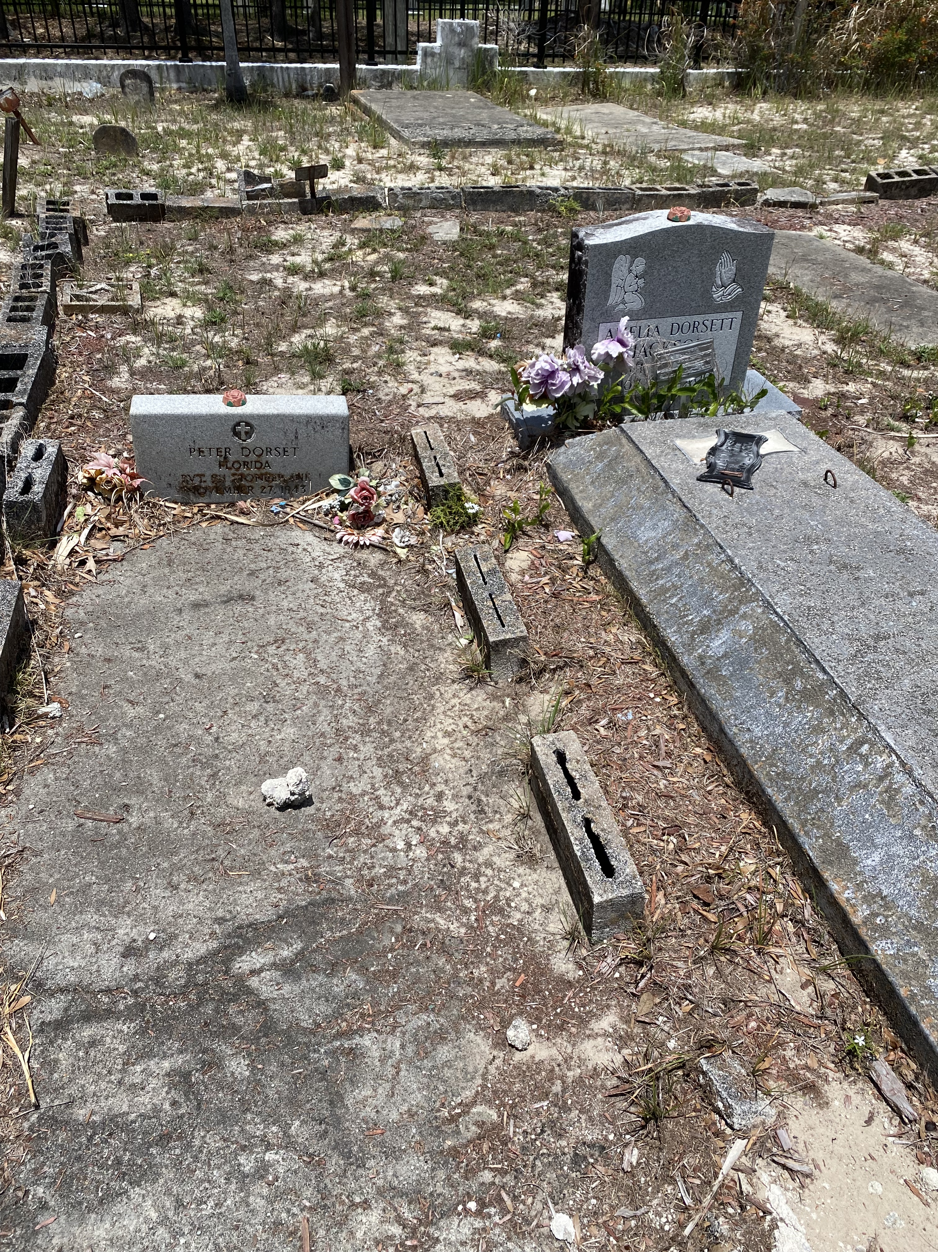
What is going on in this picture? What do you notice?

Slide 2
Why are there different types of markers? What is the difference in their quality, and why?

