Slide 1
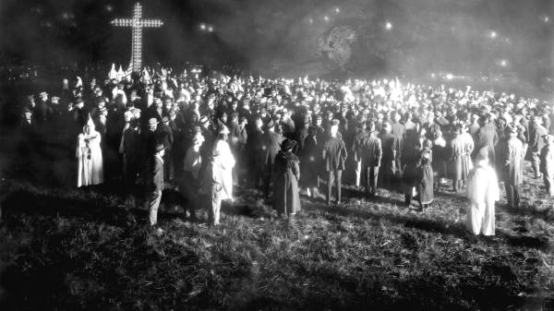

Slide 2
Tampa, Florida 1923

Slide 3
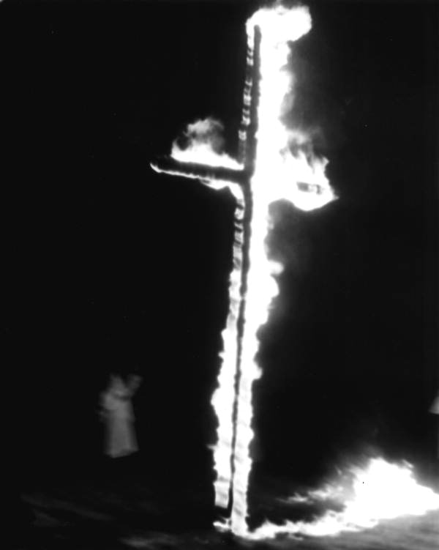
St. Augustine, Florida 1964

Slide 4
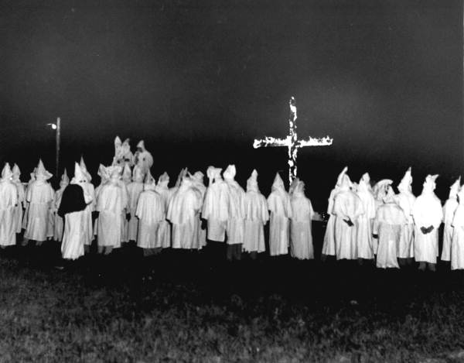
Tallahassee, Florida 1956

Slide 5
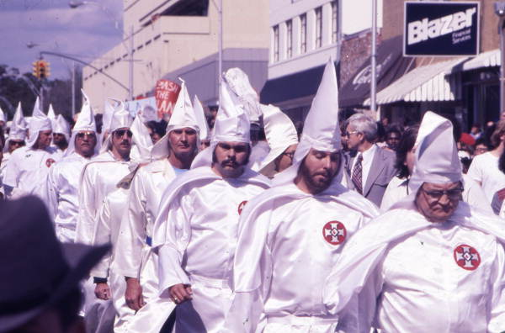
Tallahassee, Florida 1977

Slide 6
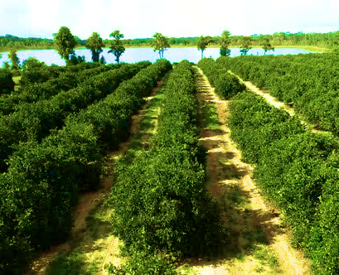
White Sheets in the Orange Groves
Essential Question: What were the effects of Florida’s Black Codes and segregationist violence on African Americans in Tarpon Springs?

