Slide 1
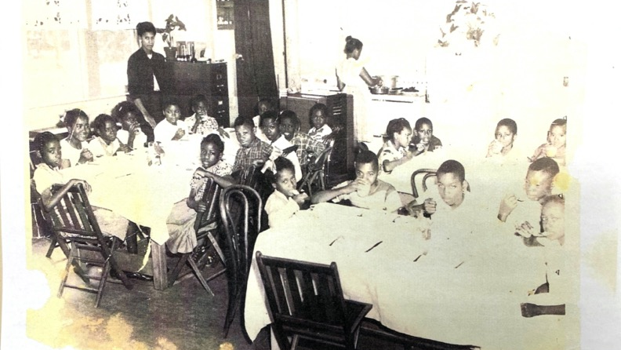

Slide 3
Brown vs. Board of Education (1954)
Supreme Court Ruling that said that the prior Supreme Court decision that allowed segregation as long as schools were “separate but equal”, was unconstitutional.
After this ruling, states were lawfully required to desegregate schools.

Slide 4
The Problem We All Live With, Norman Rockwell. (1964).

Slide 5
Racism at Little Rock, Ulloa Domingo. (1957).

